Slide 1
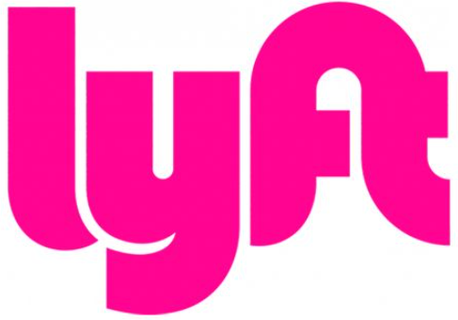
Team 06: Delivery Platform
Ryan Chu, Younghwan Choi, Jeffrey Techie-Menson, Sam Song
Notes:
Ryan

Slide 2

Why Lyft?
Notes:
Ryan

Slide 3

Background
From Zimride to Lyft, Key persons; Marcus Cohn, John Zimmer, Rajat Suri, Matt van Horn, and Logan Green in 2007
A car pooling service that connects riders and drivers who are taking similar daily commutes to work or school.
Facebook opens its API to third party developers; open source software
Green and Zimmer launched lyft in 2012 and Zimride sold in 2013 to Enterprise holdings.
Notes:
jeff

Slide 4
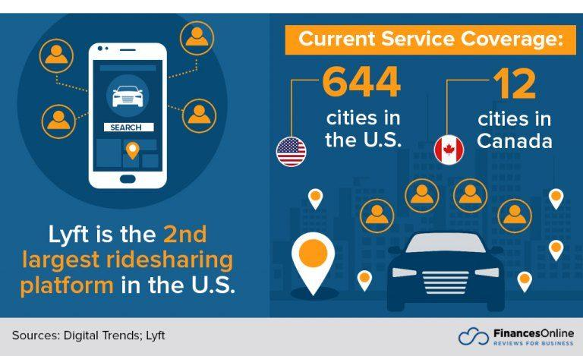
Operations
Lyft, Inc. is an American company that
develops, markets, and operates a mobile
app, offering ride-hailing, vehicles for
hire, motorized scooters, a bicycle-sharing
system and rental cars.
With a 32% market share, Lyft is the second-largest ridesharing company in North America after Uber. Lyft designs, markets, and operates a mobile application that matches drivers with passengers who request rides, and also allows payment through the app.
Notes:
https://financesonline.com/lyft-statistics/

Slide 5
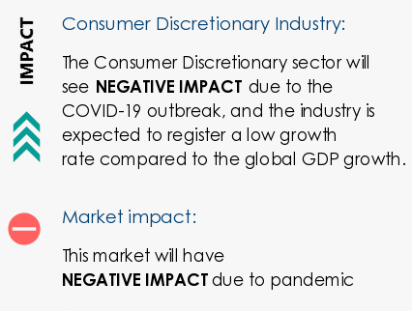
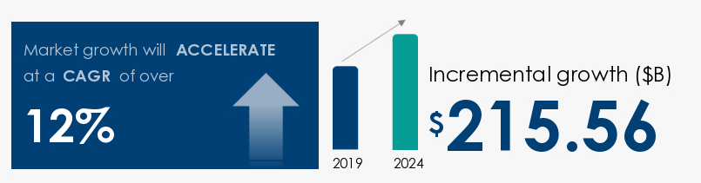
Business Problem
Add Lyft Delivery
Open up additional revenue stream for drivers
Last-Mile Delivery (Reducing/Removing Restaurant Fees)
Notes:
Ryan
https://www.businesswire.com/news/home/20201104005424/en/Global-Food-Delivery-Services-Market-to-Reach-USD-215.56-billion-by-2024-Stimulated-by-Growing-Mergers-and-Acquisitions

Slide 6
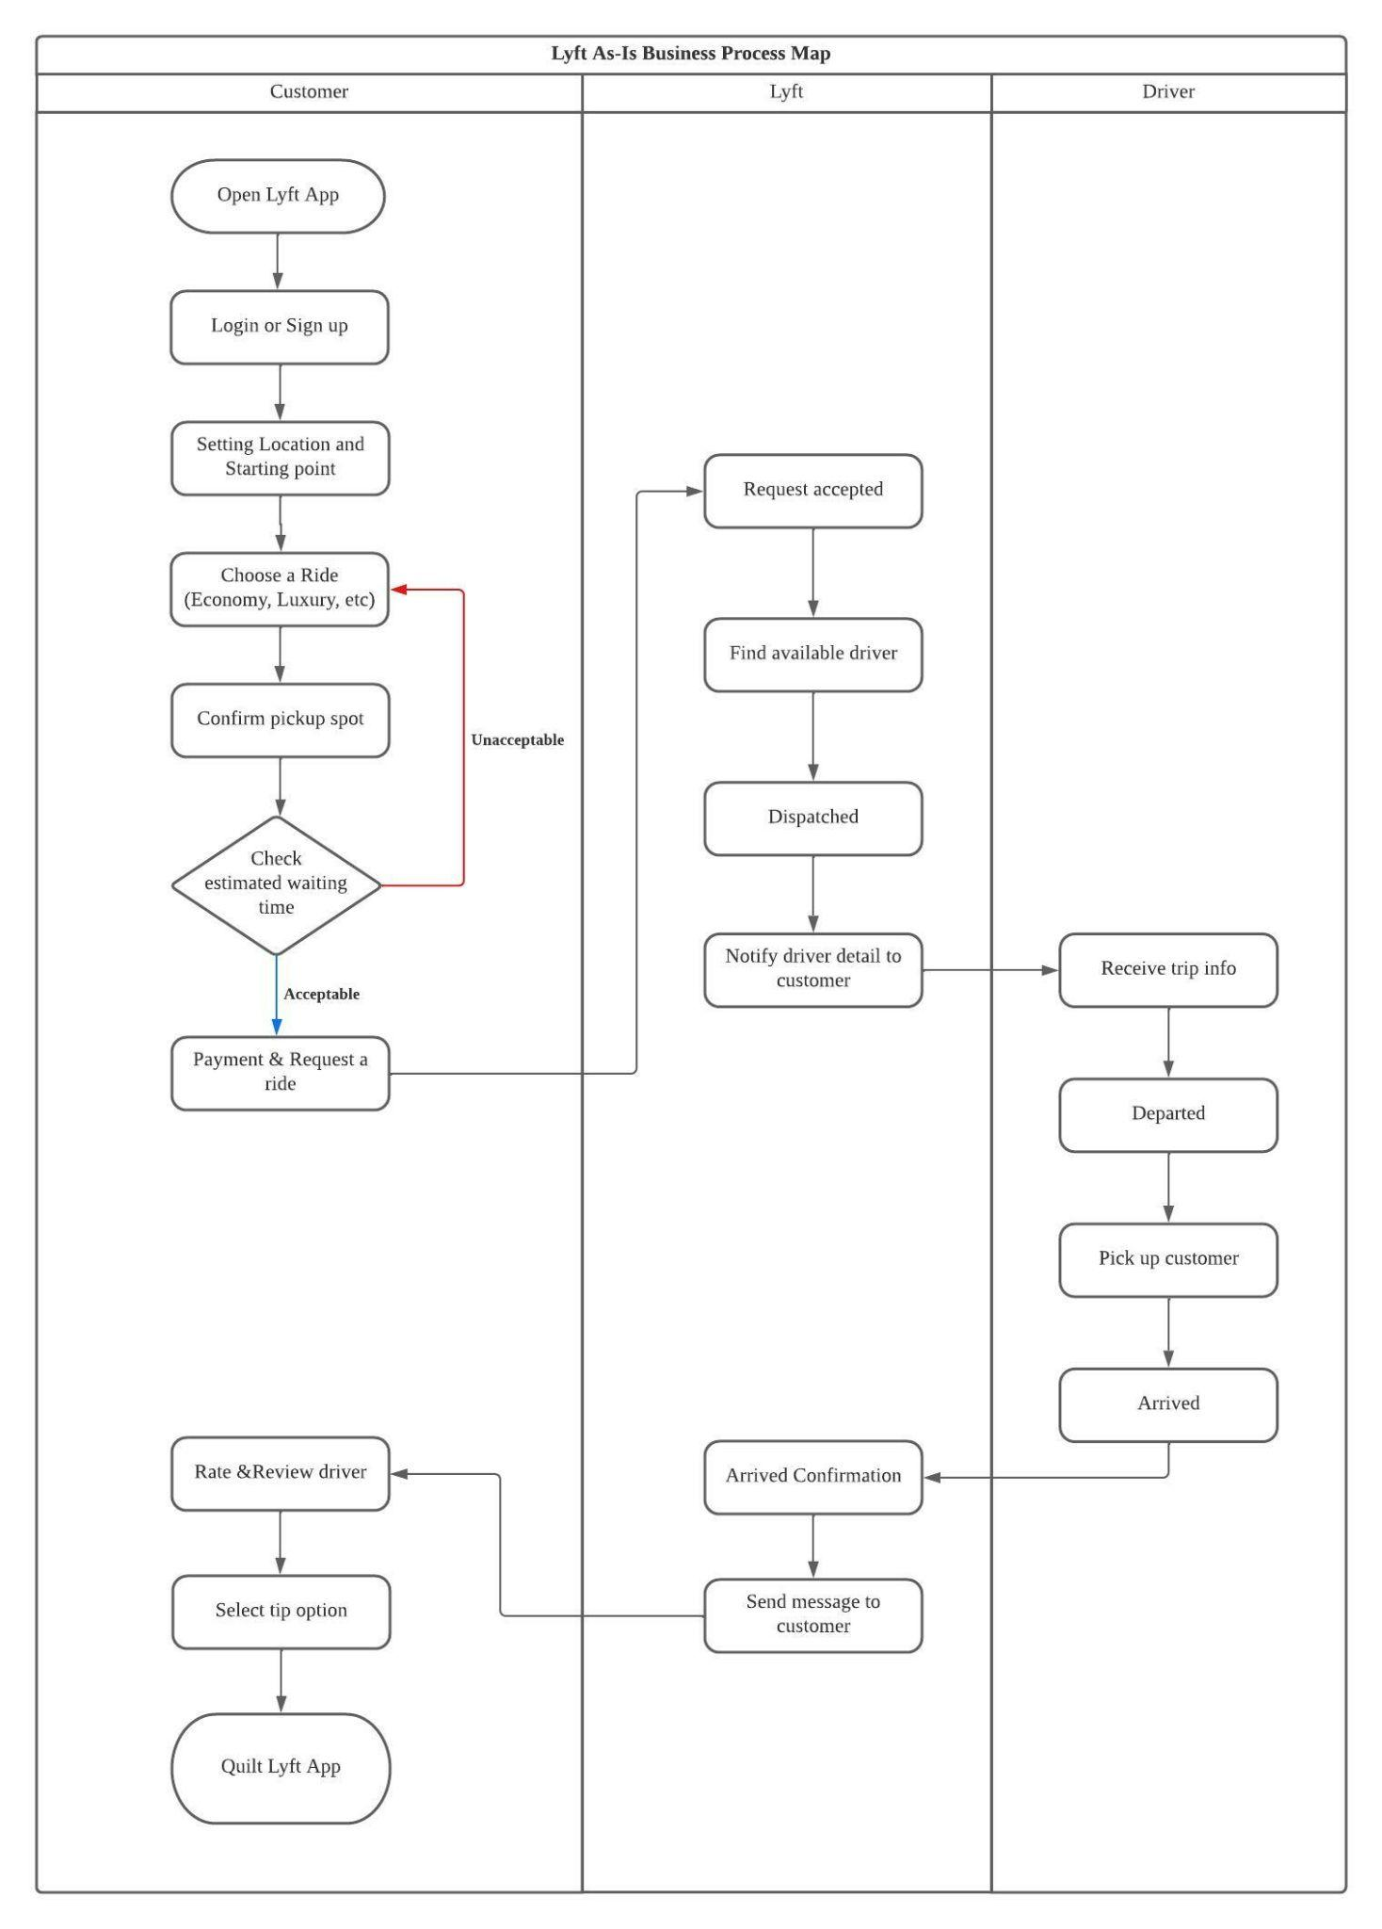
Section I: AS-IS Business Process Map
3 swim lanes
4 concepts
Confirm location
Drive request
Payment
Driver dispatch
Trip
Simple ride service process

Slide 7
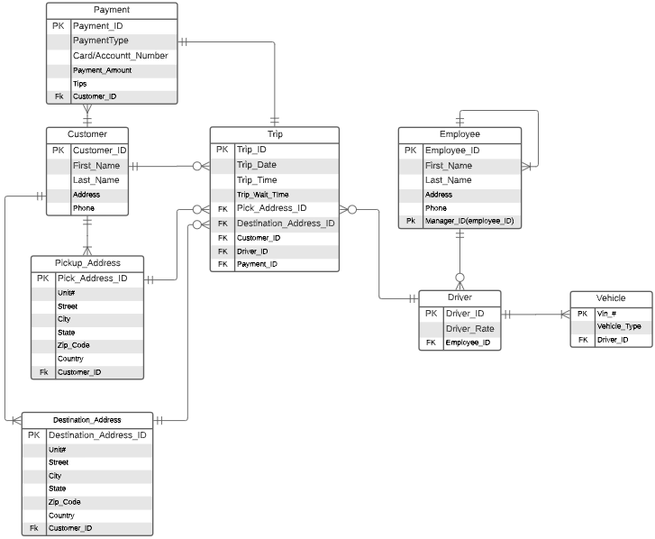
Section I: AS-IS Database ERD
Customer
Employee
Notes:
Sam

Slide 8
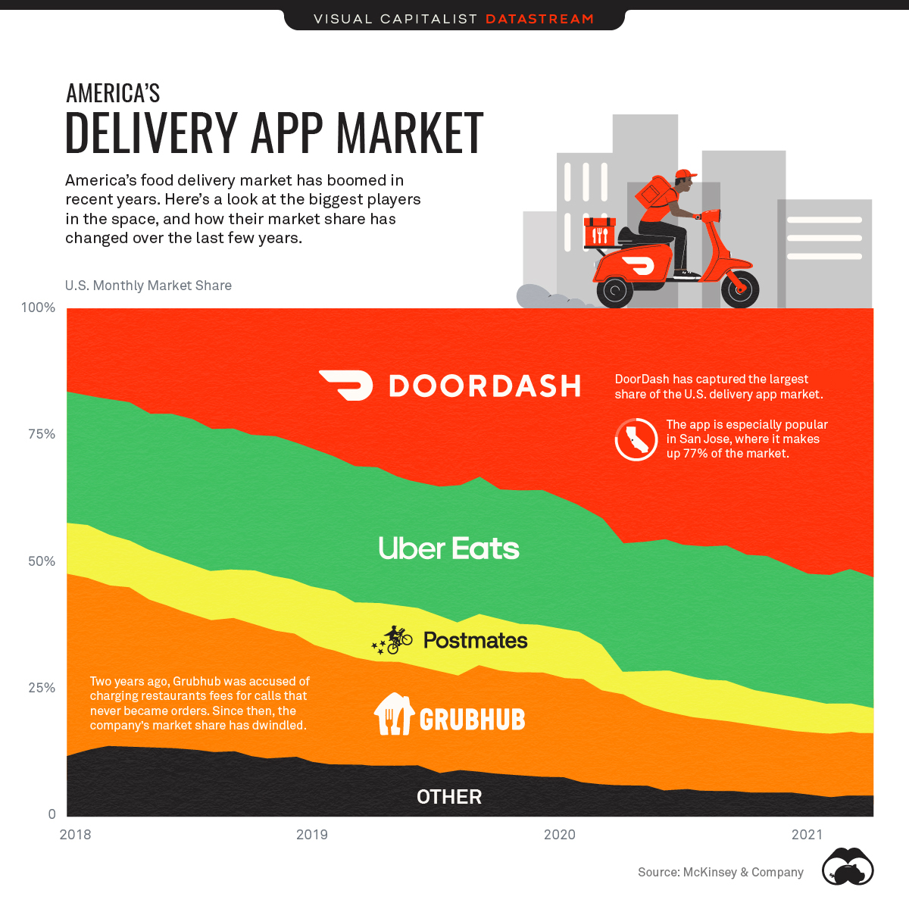
Section II: IT-Based Solution
Product Offerings
Restaurants, Retail Store, Pharmacies, Car Dealerships
Partner with Olo
Grubhub, DoorDash, UberEats
25 - U.S. Markets, 500 - Major Brands, 76,000 - Locations
Notes:
Ryan
https://www.visualcapitalist.com/doordash-is-dominating-the-u-s-food-delivery-market/

Slide 9
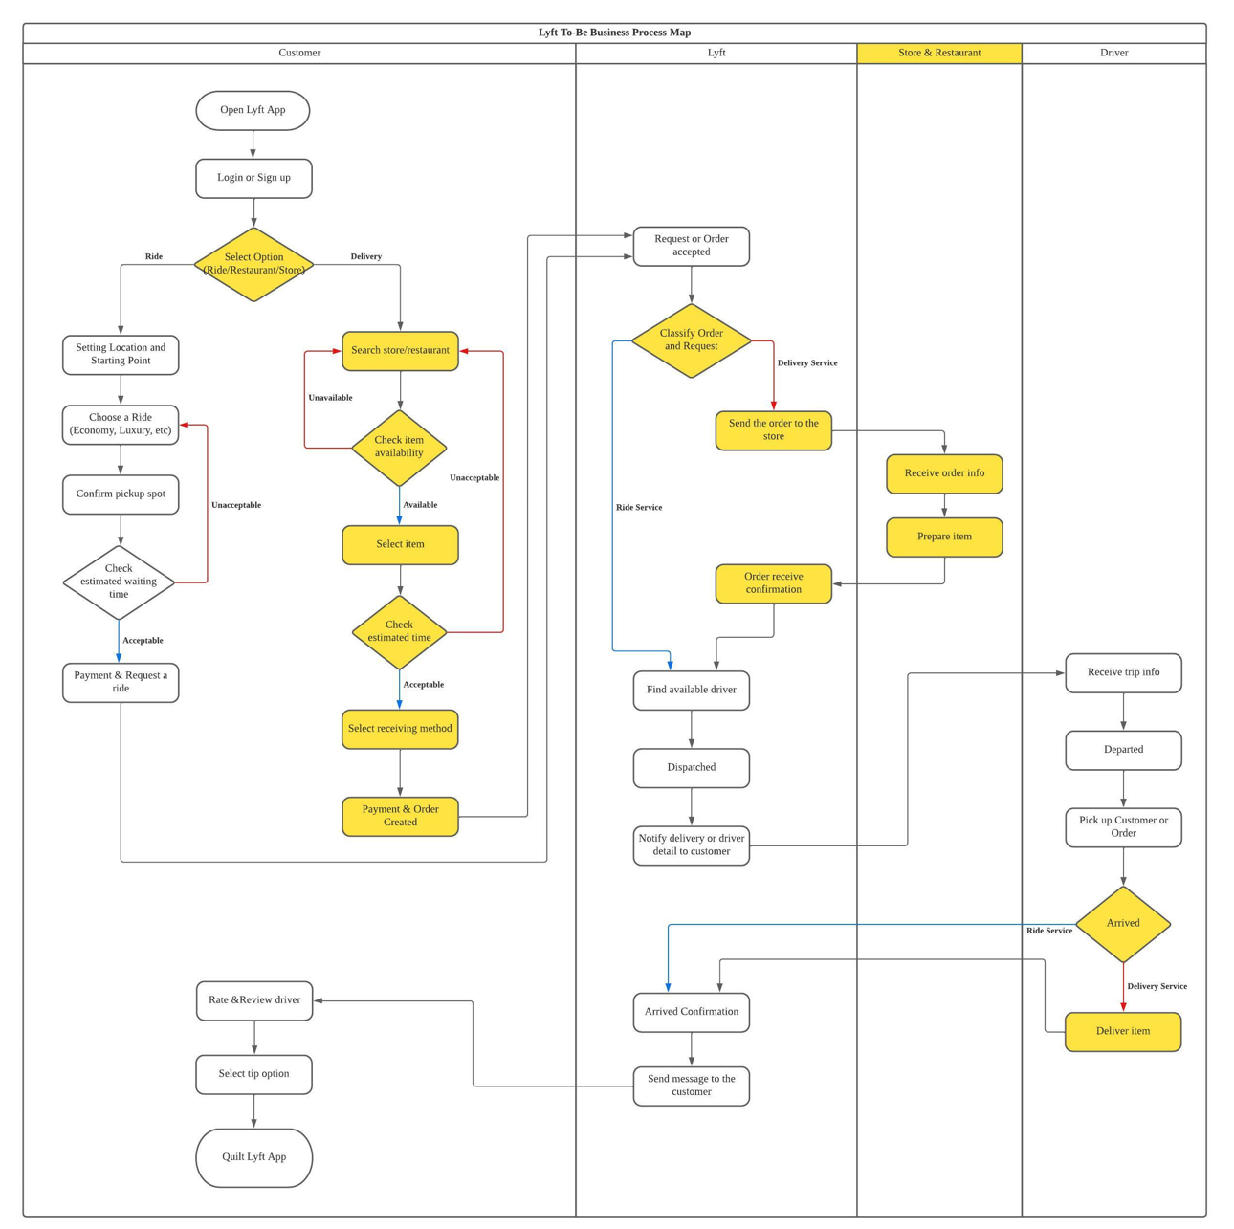
Section II: To-Be Business Process Map
4 swim lanes
(Added store & restaurant tap)
Distinction between ride and delivery service
Systematic relation between various stores
Large image

Slide 10
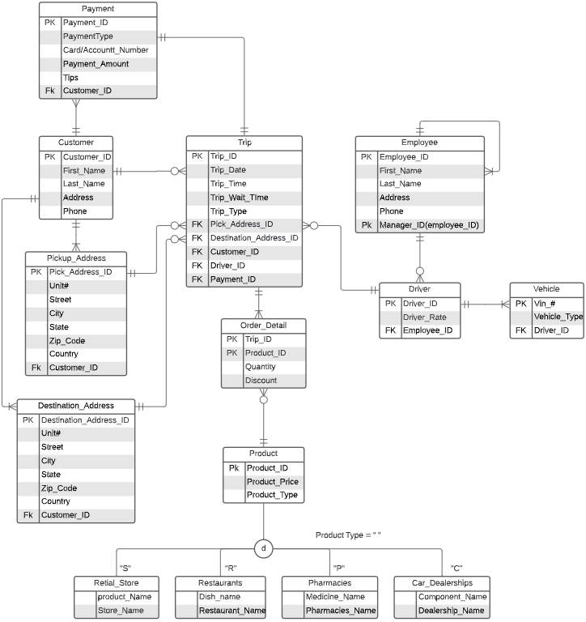
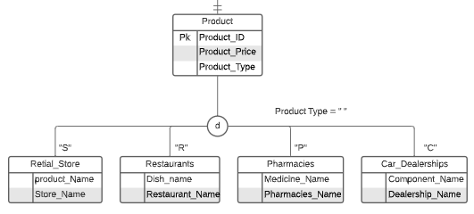
Section II: To-Be Database ERD
Adding new entity groups (Product)
4 subtype category
Order_detial entity for many to many relationship
Notes:
Sam

Slide 11
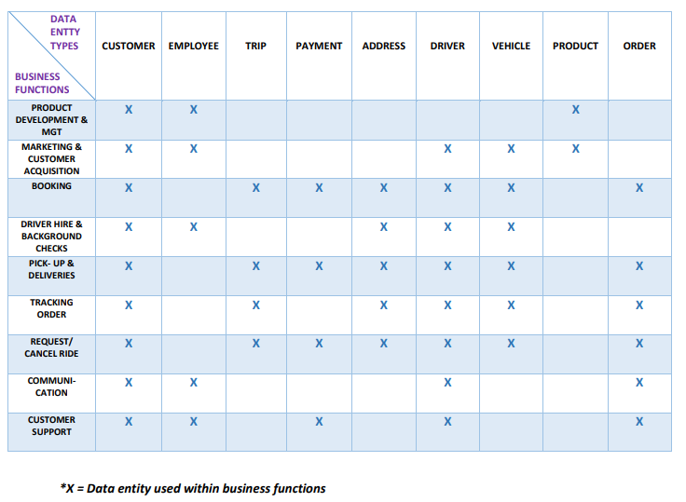
Section II: Business Function to Data Entity Matrix
One process can cover multiple functions - one function may have multiple business processes.
There are many-to-many relationships between processes and functions.
Customer entity table is a critical data entity in the business functions followed by the driver and their vehicle.
Notes:
jeff

Slide 12
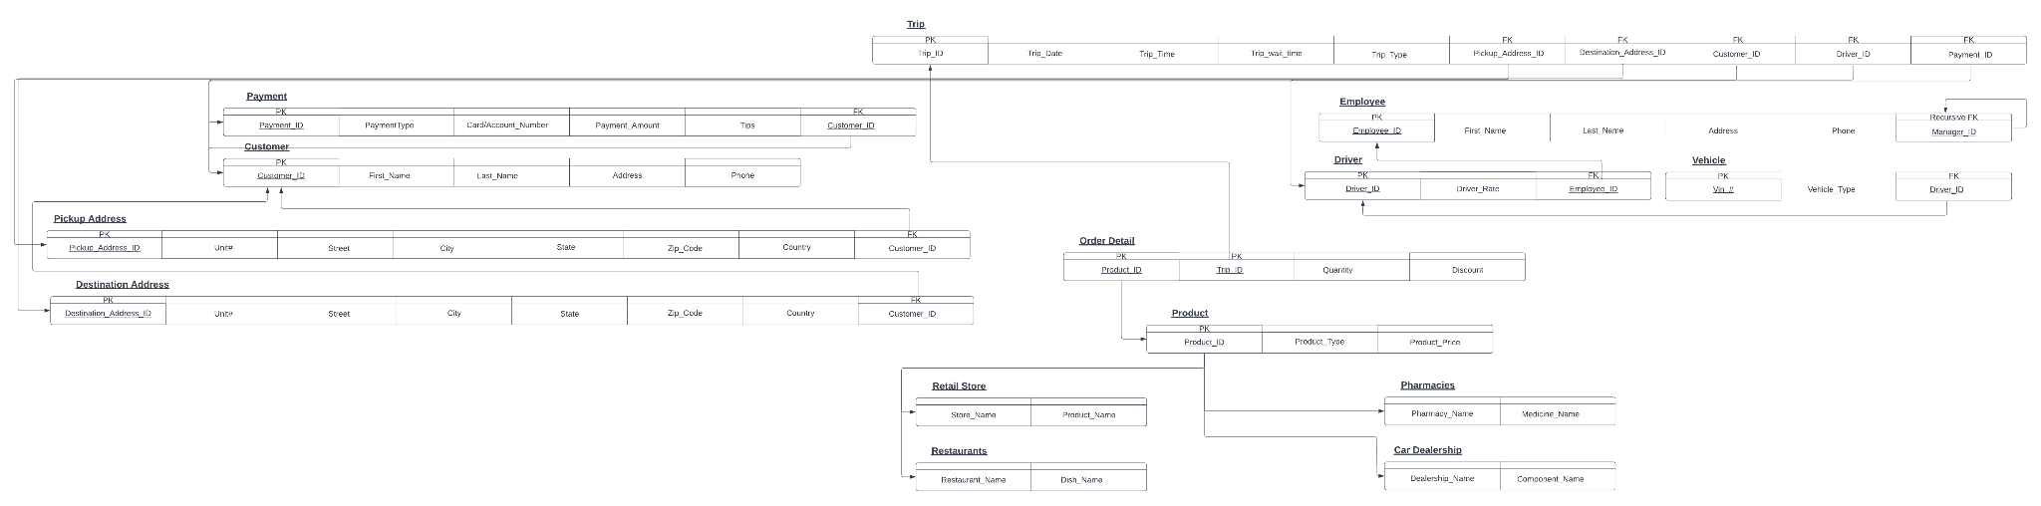
Section II: Relational Schema
The relational schema is normalized to the third normal form. By doing so we remove partial and transitive dependencies.
Notes:
Ryan

Slide 13
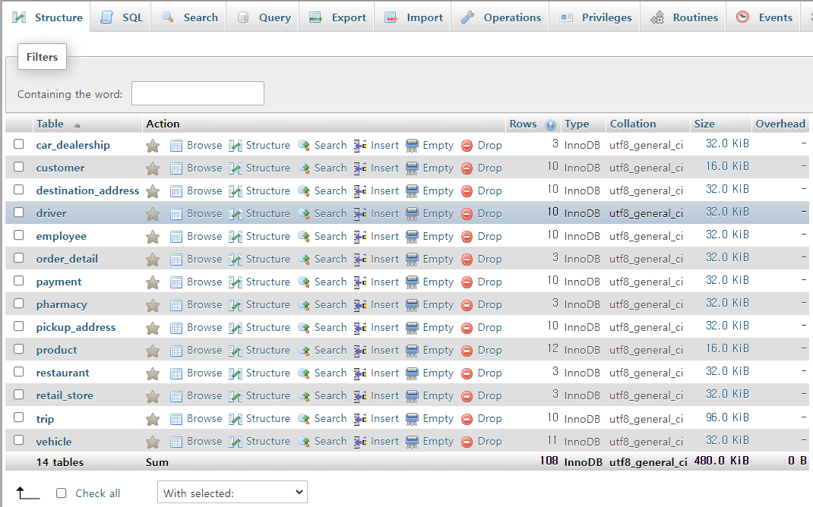
Section III
Table example
CREATE TABLE EMPLOYEE ( employee_ID int(100) NOT NULL AUTO_INCREMENT, first_name varchar(60), last_name varchar(60), address varchar(100), phone varchar(100), manager_ID int(100), PRIMARY KEY (employee_ID), FOREIGN KEY (manager_ID) REFERENCES Employee(employee_ID)
SQL example
Insert into Employee (employee_ID, first_name, last_name, address, phone, manager_ID) Values (3, 'Allan', 'Martinez', '1520 Munn Ave Hillside, New Jersey(NJ), 07205', '(973) 923-5949', 1), (4, 'Rosemarie', 'Luna', '136 Terrace Dr Middlefield, Ohio(OH), 44062', '(440) 632-9288', 1), (5, 'Kristopher', 'Alexander', '2241 Lexington Dr Barksdale Afb, Louisiana(LA), 71110', '(318) 584-6255', 1)
Notes:
Sam

Slide 14
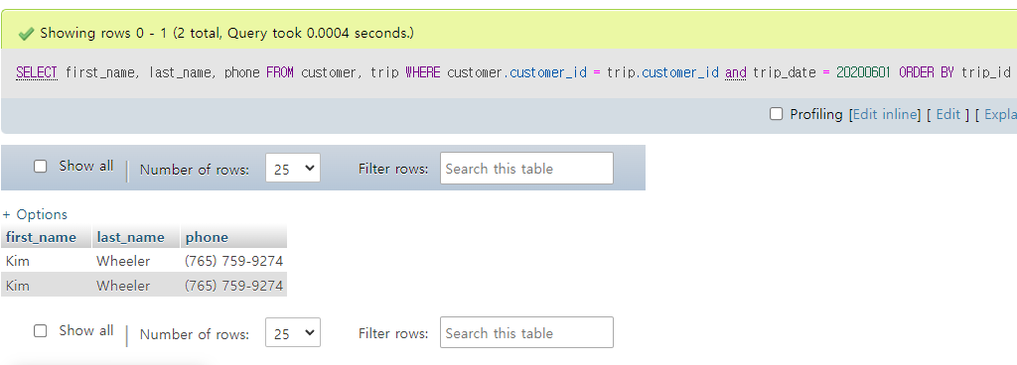
Section III
Query example (1)
Display customer information (first_name, last_name, phone, trip_type) of the trip date 2020/04/01
SELECT first_name, last_name, phone FROM customer, trip WHERE customer.customer_id = trip.customer_id AND trip_date =20200401 ORDER BY trip_id;
Notes:
Sam

Slide 15
Conclusion
Expected Outcomes
Limitations
Any other implications and discussion?
…
Notes:
Sam

Slide 16
Questions?
Thank You!

